Slide 1
Java 4 WEB
Lesson 12 - Home Task Overview

Slide 2
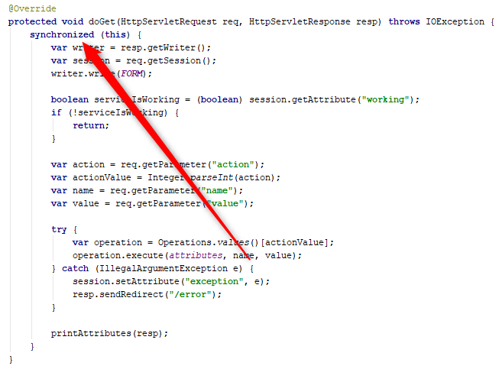
1. Synchronization?

Slide 3

2. doGet is not the same to doPost

Slide 4
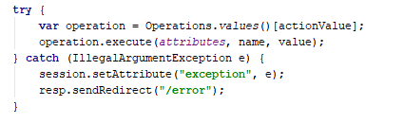
3. Tightly coupled code
Notes:
When you will need separate handler for another exception, how will you handle it?

Slide 5
4. Lookup by ordinal is unsafe
Notes:
When you will need separate handler for another exception, how will you handle it?

Slide 6
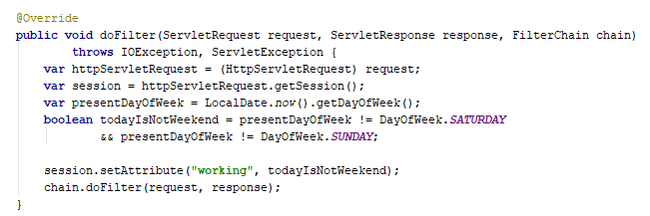
5. Follow single responsibility principle
Notes:
Extract blocking rule check to separatemethod

Slide 7
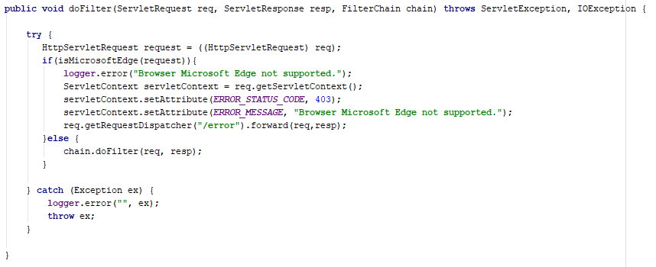
5. Follow single responsibility principle
Notes:
Servlet should do only business logic. Error handling is not his task

Slide 8
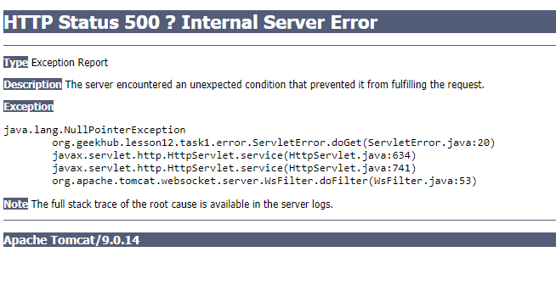
6. Handle errors correctly

Slide 9

7. Use correct dependency scope

Slide 10
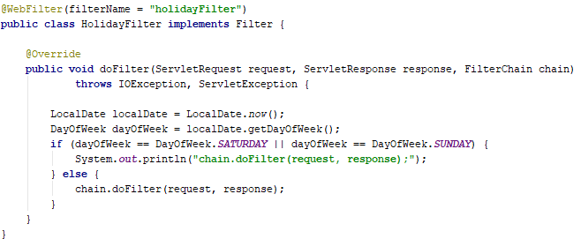
8. Filtering should block request
Notes:
When ci fails, student get 0

Slide 11
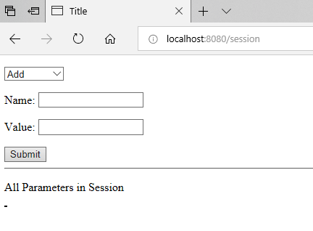
8. Test your code

Slide 12

9. Continuous integration should not fail
Notes:
When ci fails, student get 0

Slide 13
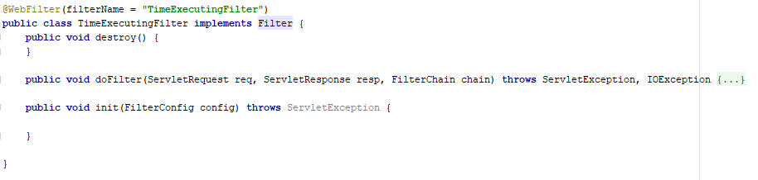
10. Useless code

Slide 14
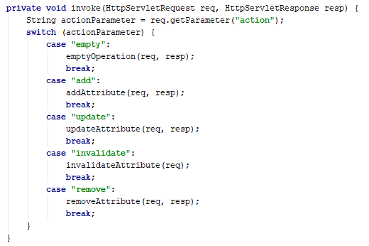
11. Prefer polymorphic solutions

Slide 15
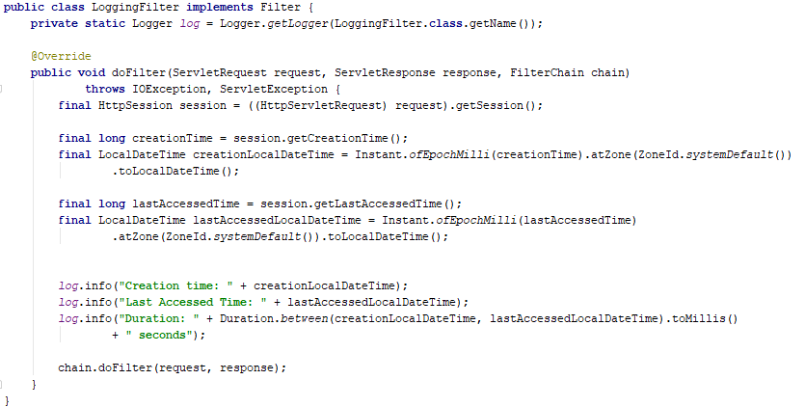
12. Where is request execution info?

Slide 16
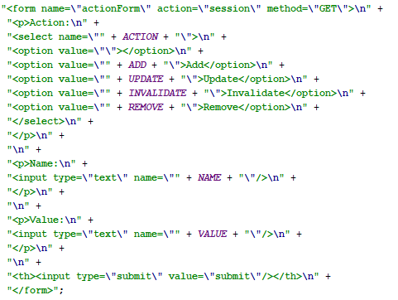
13. Use correct http methods

Slide 17
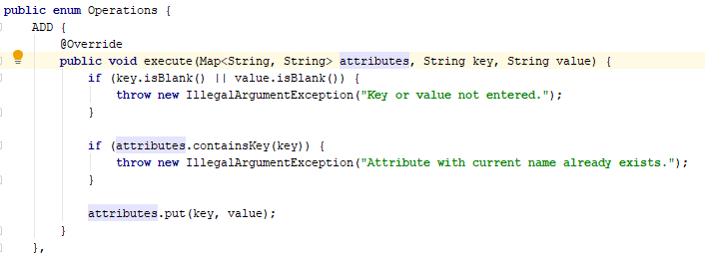
14. Modification of input arguments is bad

Slide 18
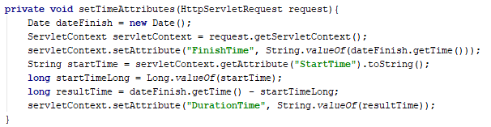
15. Only single instance of Servlet Context

